Slide 1

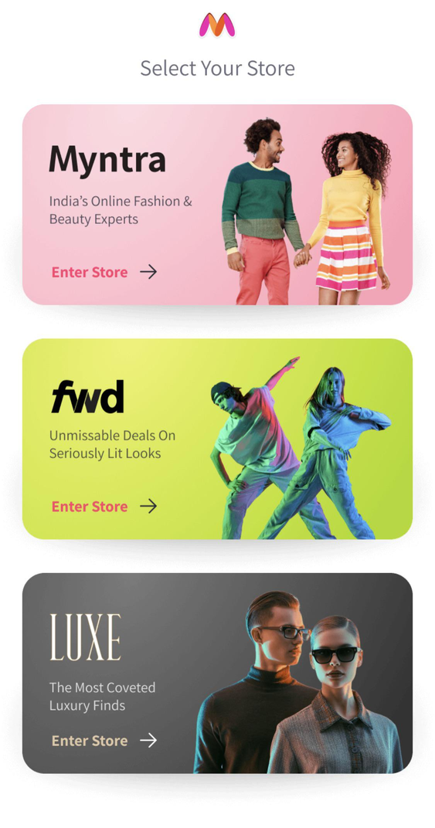




A one-stop shop for all your fashion and lifestyle needs
Presented By:
Bala Muralidhar Reddy

Slide 2


Overview
A Brief History of Myntra
Business Model
Market Position and Competitors
Marketing Mix
Website Ranking
SWOT Analysis of Myntra
Myntra’s sentiment Analysis - Impact on Business
Recommendations

Slide 3


A Brief History of Myntra
New Family
Myntra was acquired by Flipkart, India's largest e-commerce company
The Shift
Myntra pivoted to focus exclusively on fashion.
The Start
Personalized gifting platform, offering customized products like T-shirts and mugs.
2018
Walmart, one of the world's largest retailers, acquired a majority stake in Flipkart
2011
2014
2007

Slide 4

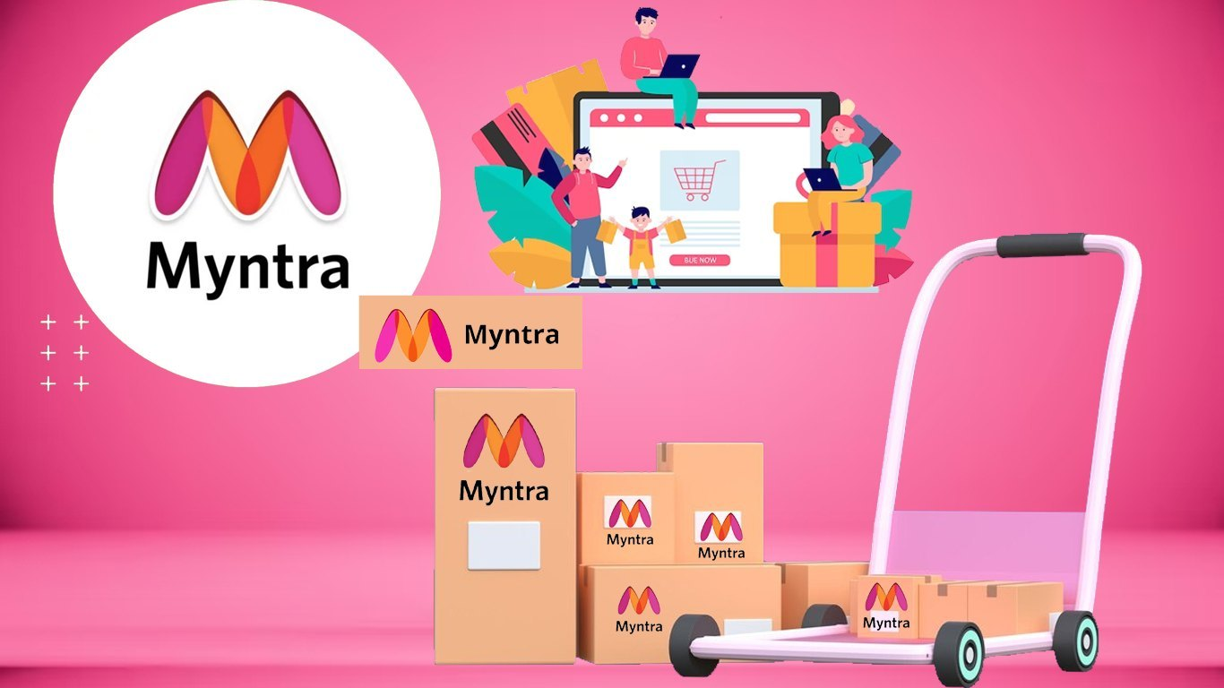





Business Model-Myntra
Myntra is a leading online fashion retail platform in India
Commission Fees
Myntra earns a commission on every product sold through its platform. This fee is typically a percentage of the product's selling price.
Advertising
Myntra offers advertising opportunities to brands and sellers, allowing them to promote their products to a wider audience.
Private Label Products
Myntra also has its own private label brands, generating additional revenue from the sale of these products.

Slide 5




Amazon Fashion: Known for its vast range and customer trust.
Flipkart Fashion: Strong in the Indian market with competitive pricing.
Market Position and Competitors
Ajio: Reliance-backed, known for its unique collections and branding..
Myntra continues to hold a dominant position in the Indian online fashion market. It's estimated to have a market share of around 40-45%.
Nykaa Fashion: A rising star in the fashion e-commerce sector.
Tata CLiQ: Offers a premium shopping experience with a focus on quality.
Brand Websites : Nowadays, every brand has their own digital footprint

Slide 6
Marketing Mix
Product
Price
Place
Promotion
Myntra
Clothing, footwear, accessories, and beauty products for men, women, and children.
competitive pricing, often with regular sales and discounts.
online marketplace
mix of digital marketing channels, including social media, email marketing, and influencer partnerships.
Amazon Fashion
offers a vast selection of fashion products, with a focus on international brands.
competitive pricing
online marketplace
mix of digital marketing channels, including social media
AJIO
Focuses on Indian brands and offers a curated selection of trendy fashion items.
affordable prices and frequent discounts, budget-conscious shoppers
online marketplace and Trends
digital marketing
TataCliq
Offers a wide range of products, including fashion, electronics, and home goods.
competitive pricing, especially for products from the Tata Group
online marketplace
digital marketing and partnerships
Nykaa
Primarily a beauty and personal care platform, Nykaa also offers a limited range of fashion accessories.
Quality conscious's higher side in terms of pricing
online marketplace with physical stores in select cities.
personal care influencers

Slide 7
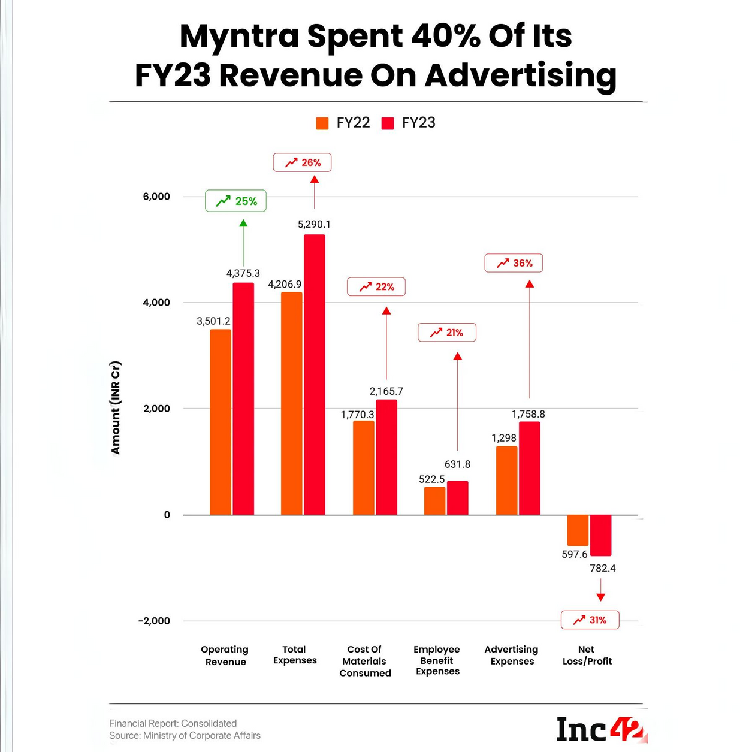
Where Did Myntra Spend?
01
Cost Of Materials Consumed: The startup spent INR 2,165.7 Cr on procurement, an increase of 22% from INR 1,770 Cr in FY22. .
02
Advertising Expenses: Myntra spent almost 40% of its revenue from operations on advertising in FY23. Its advertising expenses zoomed 36% to INR 1,758.8 Cr from INR 1,298 Cr in FY22.
03
Employee Benefit Expenses: Employee costs rose 21% to INR 631.8 Cr in FY23 from INR 522.5 Cr in the previous fiscal year.

Slide 8
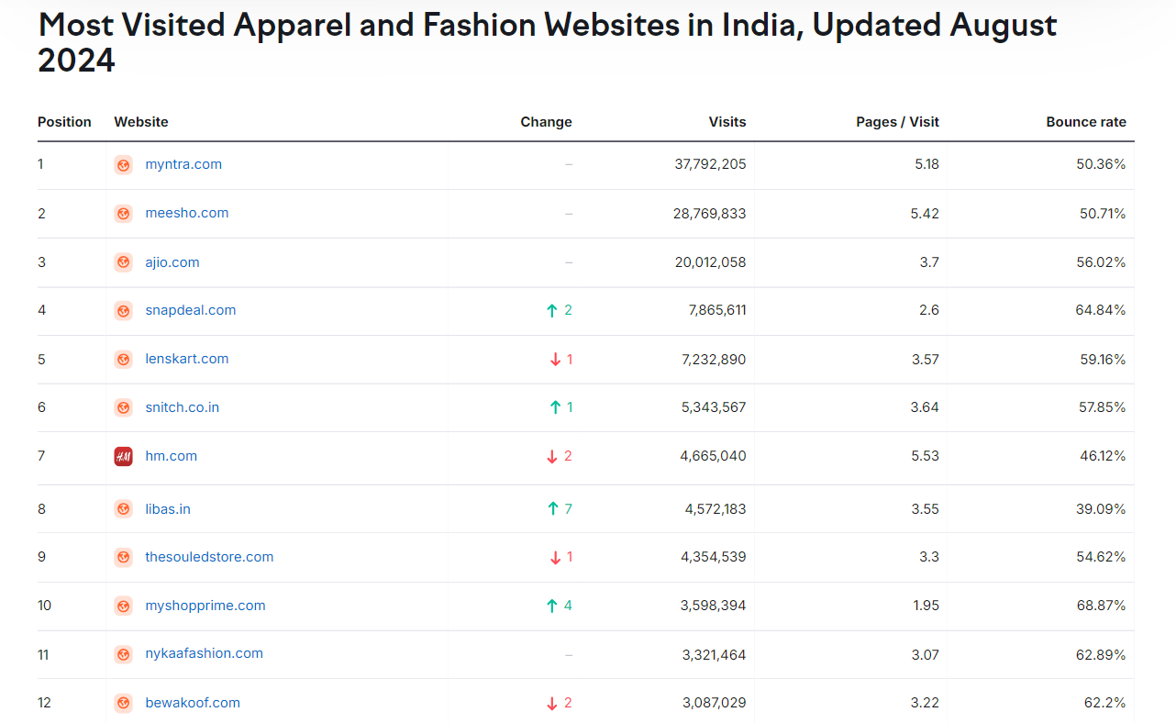

Slide 9
SWOT Analysis of Myntra
Strengths
Weaknesses
Opportunities
Threats
Strong Brand Recognition: Myntra has established itself as a leading online fashion brand in India
Wide Product Range: The platform offers a vast selection of fashion products, catering to diverse customer preferences.
Strong Partnerships: Myntra has forged partnerships with numerous brands, both international and domestic
Technology-Driven Platform: The platform leverages technology to enhance the shopping experience, including features like personalized recommendations, virtual try-on, and easy returns
Dependency on Third-Party Logistics: While Myntra has its logistics network, it still relies on third-party logistics providers for some deliveries, which can potentially impact delivery times and customer satisfaction.
Competition from Global Giants: Myntra faces competition from giants like Amazon, Ajio and Tata, which have deep pockets and extensive resources.
Rising Costs: Increasing operating costs, including logistics, marketing, and technology, can impact Myntra's profitability.
Expanding Product Categories: Myntra can further expand its product offerings to include home decor, electronics, and other lifestyle products.
Offline Presence: Establishing a physical presence through pop-up stores or experience centers can enhance brand visibility and customer engagement.
International Expansion: Myntra can explore opportunities to expand its operations to other countries with similar fashion preferences.
Intensifying Competition: The online fashion market is highly competitive, with new players entering the market and existing ones investing heavily in growth.
Changing Consumer Preferences: Evolving fashion trends and consumer preferences can pose challenges to Myntra's product offerings and marketing strategies.

Slide 10
Myntra’s sentiment Analysis - Impact on Business
Collected the recent reviews from myntra website and used gemini AI to segregate the reviews into three categories
High Impact
Medium Impact
Low Impact
Wrong Items Delivered: This is a recurring issue with significant financial and reputational consequences.
Poor Return & Refund Policy: A cumbersome or unfair return and refund policy frustrates customers and discourages them from shopping at Myntra.
Unresponsive Customer Care: Customers who can't reach customer care or receive unhelpful responses are more likely to abandon Myntra altogether.
Delayed Deliveries: While not as severe as wrong items, delayed deliveries can still lead to customer dissatisfaction and missed sales opportunities.
Inaccurate Product Descriptions: Customers who receive products that don't match the descriptions online may be disappointed and less likely to trust Myntra in the future.
Damaged Products: Damaged products can be frustrating for customers, but Myntra's return policy should address this.
Unclear Shipping Costs: If shipping costs are not clearly communicated upfront, customers may feel misled or dissatisfied.

Slide 11

Recommendations
Improve Order Accuracy: Implement stricter quality control measures to ensure correct items are shipped.
Simplify Return & Refund Process: Make it easy and hassle-free for customers to return unwanted or wrong items.
Enhance Customer Service: Train customer service representatives to be responsive, empathetic, and offer solutions.
Transparency in Delivery Timelines: Clearly communicate realistic delivery timeframes and update customers on any delays.
Accurate Product Descriptions: Ensure product descriptions and images accurately reflect the items being sold.

Slide 12


